Slide 1
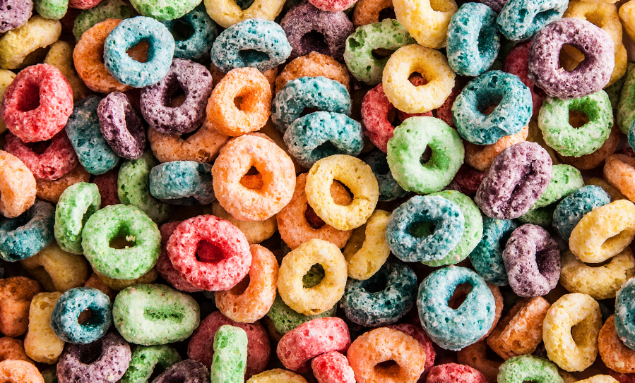
Loops

Slide 2
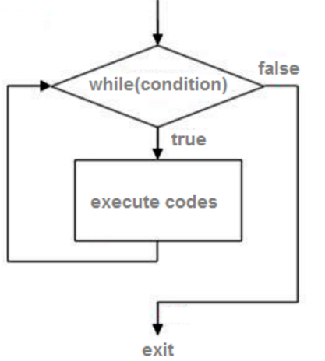
While Loops
Always tests a condition

Slide 3
For Loops
Used to iterate over a set of data or range
> for <variable> in <sequence>
Sequence can be a range or a set of data
Examples:
  > for number in range(1, 10) #will print the numbers 1 – 9
  > for item in shopping_list #where shopping_list is a python list

Slide 4
Nested Loops
Loops within Loops
Sometimes difficult to get your head round

